Slide 1
Sprocket Central Pty Ltd
Wajiha Ahmed

Slide 2
Today Agenda
Project Recap
Problem
Process
Insights
Recommendation

Slide 3
Project Recap
Sprocket Central Pty Ltd is a long-standing KPMG client whom specializes in high-quality bikes and accessible cycling accessories to riders. Their marketing team is looking to boost business by analyzing their customer dataset to determine customer trends and behavior.

Slide 4
Problem
What are the trends in the underlying data?
Which customer segment has the highest customer value?
What marketing and growth strategy we purpose to Sprocket Central Pty Ltd ?

Slide 5
Process
Data Understanding
Data Cleaning
Data Modeling
Data Analysis
Data Insights

Slide 6
Insights

Slide 7
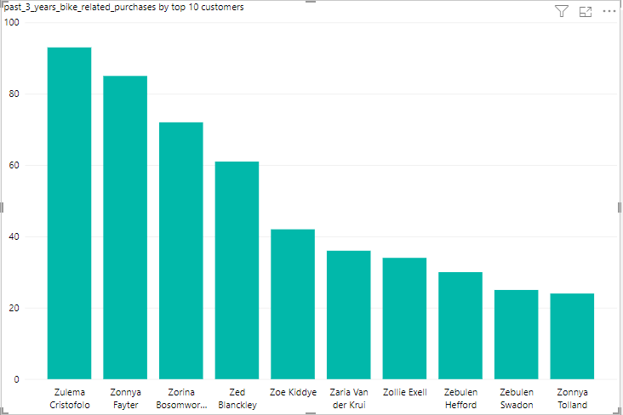
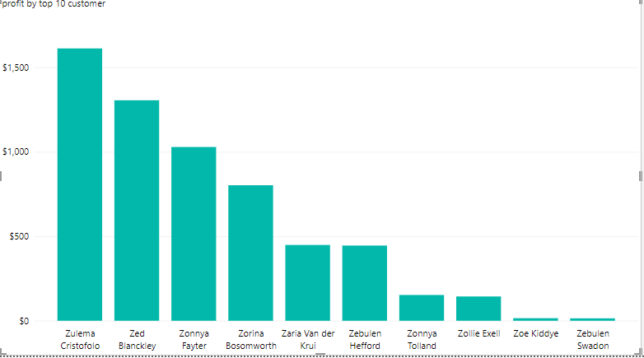
Top customers by Profit and customers purchases more products since last 3 years
Customers that gives us more profit.
Zulema Cristofolo
Zed Blanckley
Customers that buy more products.
Zulema Cristofolo
Zonney Fayter

Slide 8
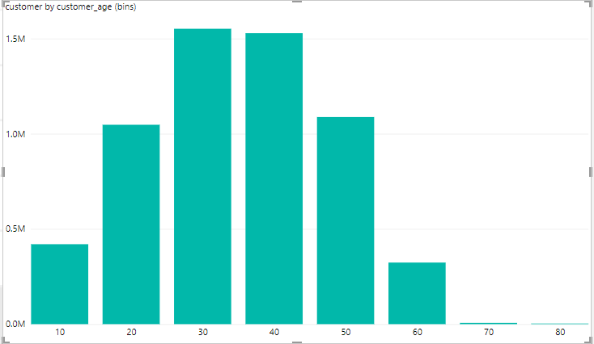
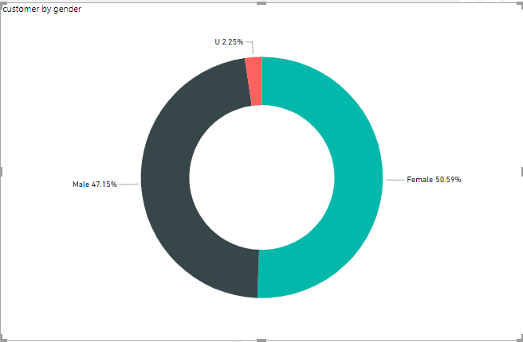
Which Age Period/Gender has more Customers
Females are 3.44% more than Males.
Mostly Customers are between age of 21 to 40.

Slide 9
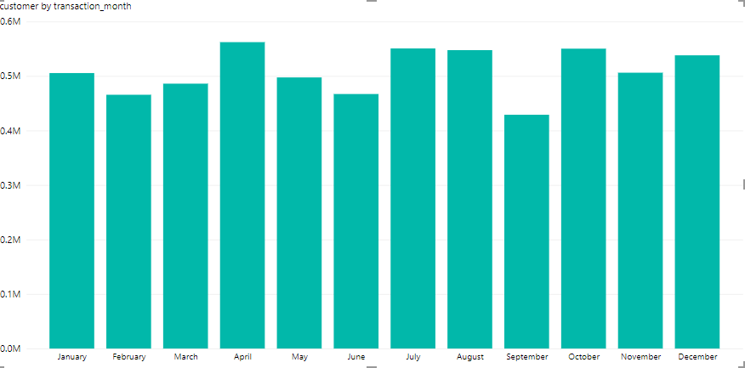
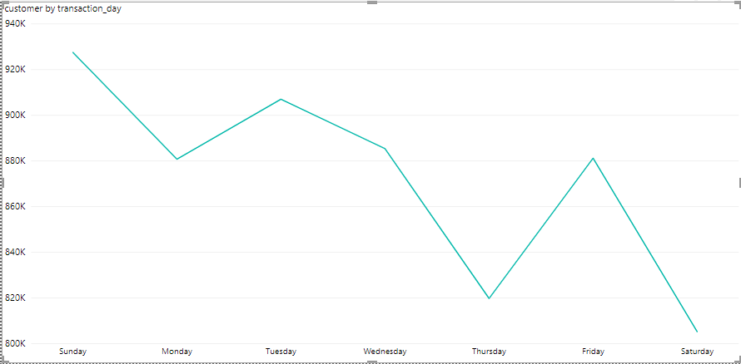
Which Month/Day has more Customers
In the month of April and Day of Sunday we have more customers transactions.

Slide 10
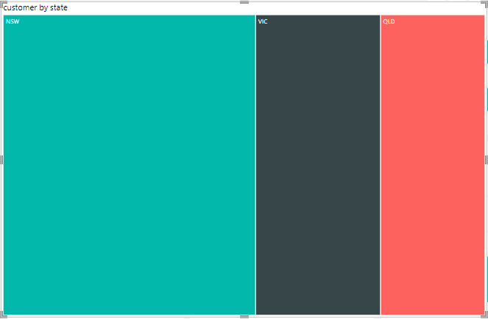
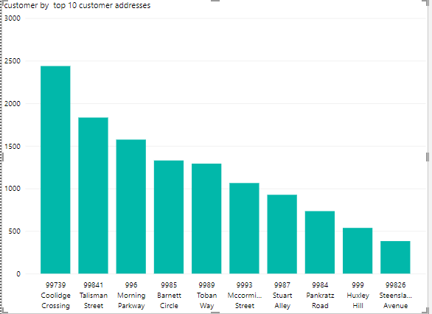
In which Region There are more Customers
We have more customers in region of North South Wales and Coolidge Crossing

Slide 11
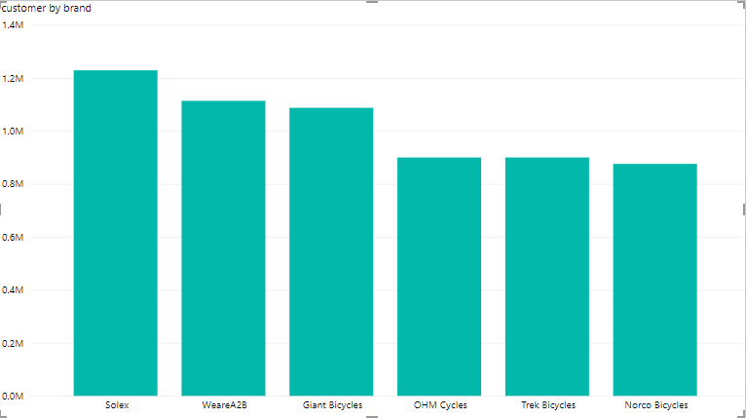
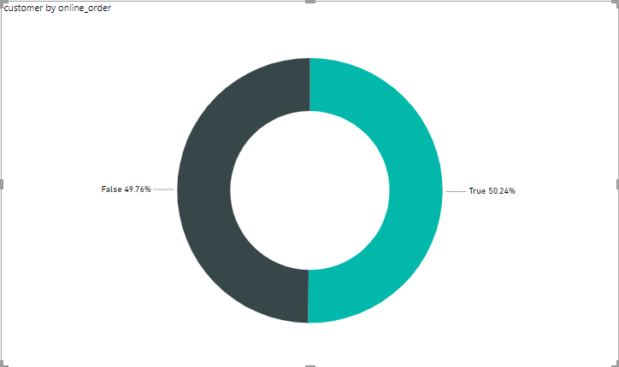
Customer Interest in Brand/Online order
Solex is more famous brand than other brands.
Online orders are 0.48% more than physical orders.

Slide 12
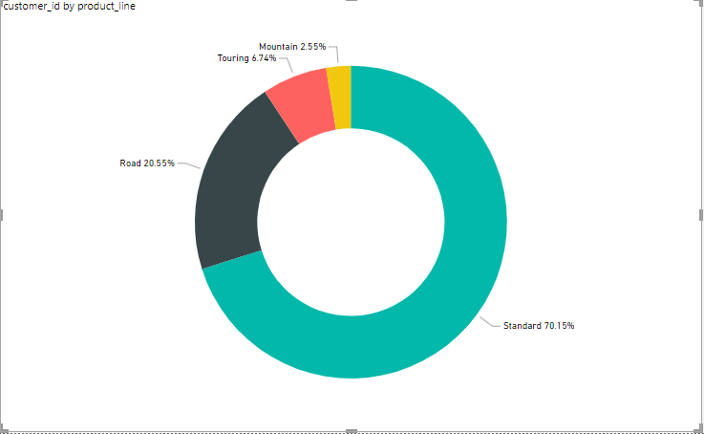
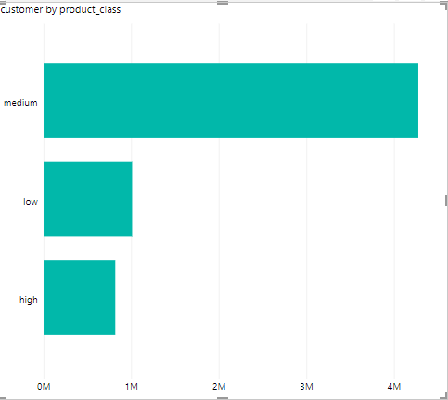
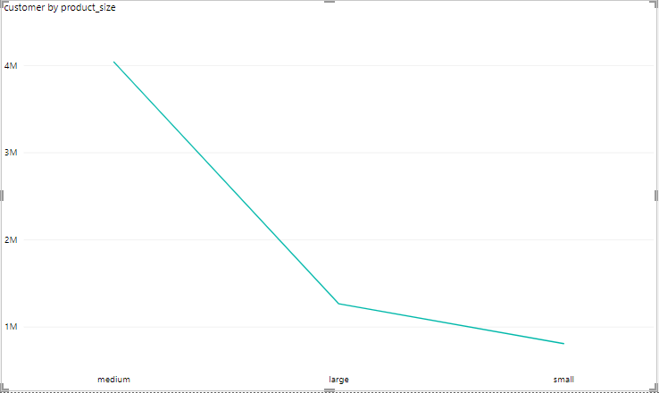
Customer Interest in Product
Mostly customers buy medium product class and product size.
Standard product line which is 39.85% more than other product line.

Slide 13
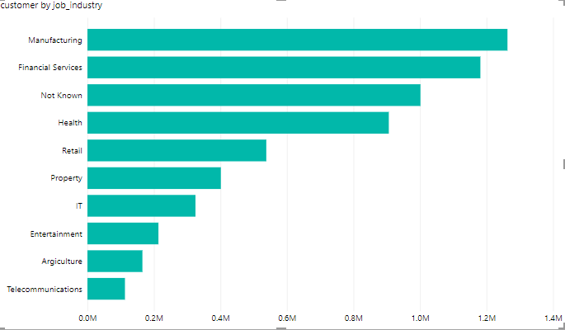
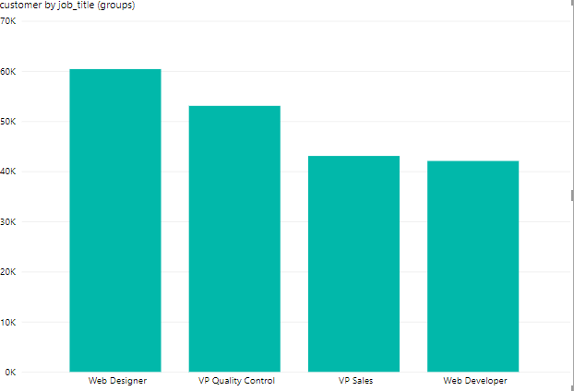
Customers having more purchases in past 3 years
Mostly customers are related in Manufacturing and finical services job industry.
Mostly Customers are Web Designer

Slide 14
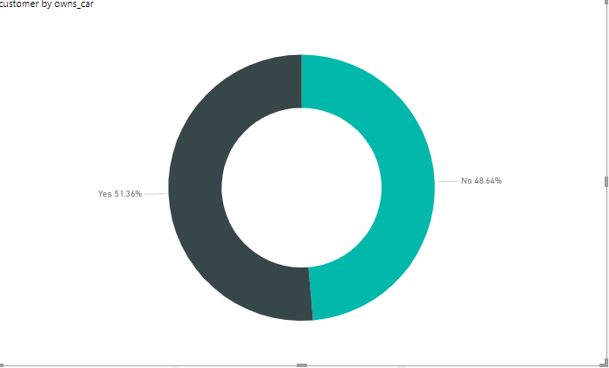
Customers having more purchases in past 3 years
51.36% customers have cars.

Slide 15
Summary

Slide 16
Sprocket Central Pty Ltd mostly customers are between age of 21 to 40 ,female gender is 3.44% more than male gender, April and Sunday have time of more traffic, mostly customers are living in state of New South Wales ,Solex is famous brand in customers, there is 0.43% increase in online purchases than physical purchases, Mostly customers buy medium product class and product size, Standard product line purchases is 39.85% more than other product line. Mostly customers are related in Manufacturing and finical services job industry and Customers are Web Designer,51.36% customers have cars.

Slide 17
Recommendation

Slide 18
We highly recommended Sprocket Central Pty Ltd that they should target customers of age 21 to 40, they should target both the genders Male and Female although there is slight increase in females quantity but its not matter much more, they should target all types of customers having cars or not having cars because as shown in our analysis customers having cars or not both buy products of Sprocket Central Pty Ltd .
We highly recommended that Sprocket Central Pty Ltd launch a campaign defining Sprocket Central Pty Ltd services targeting customers in month of April or in Sunday because they is time of more traffic.
They should create an app in which Sprocket Central Pty Ltd tells about their new products and offers.

Slide 19
Thank You

